Slide 1
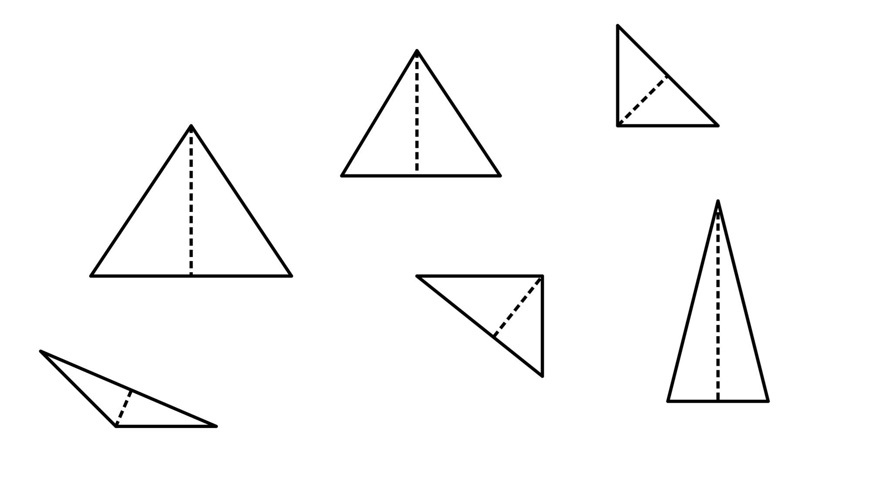
Diagonals of a rhombus
Task A: Isosceles triangles
1) Decide which of the following are isosceles triangles. If not, state why not.
a)
31°
b)
isosceles
c)
74°
isosceles
2.3 cm
isosceles
2.3 cm
53°
59°
d)
e)
f)
73°
19 mm
4 m
4 m
73°
1.8 cm
isosceles
Not an isosceles; the altitude does not bisect the base edge.
Not an isosceles; there are not two equal edges
2) Add notation marks to the diagrams, where appropriate.
a)
b)
13 cm
27°
27°
13 cm
c)
45°

Slide 2
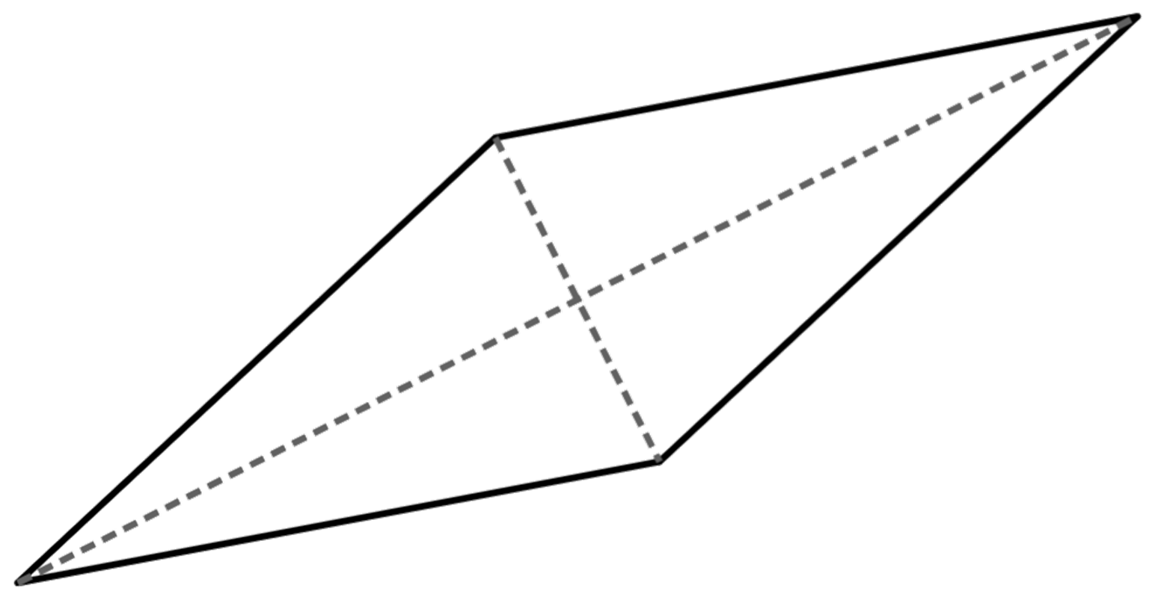
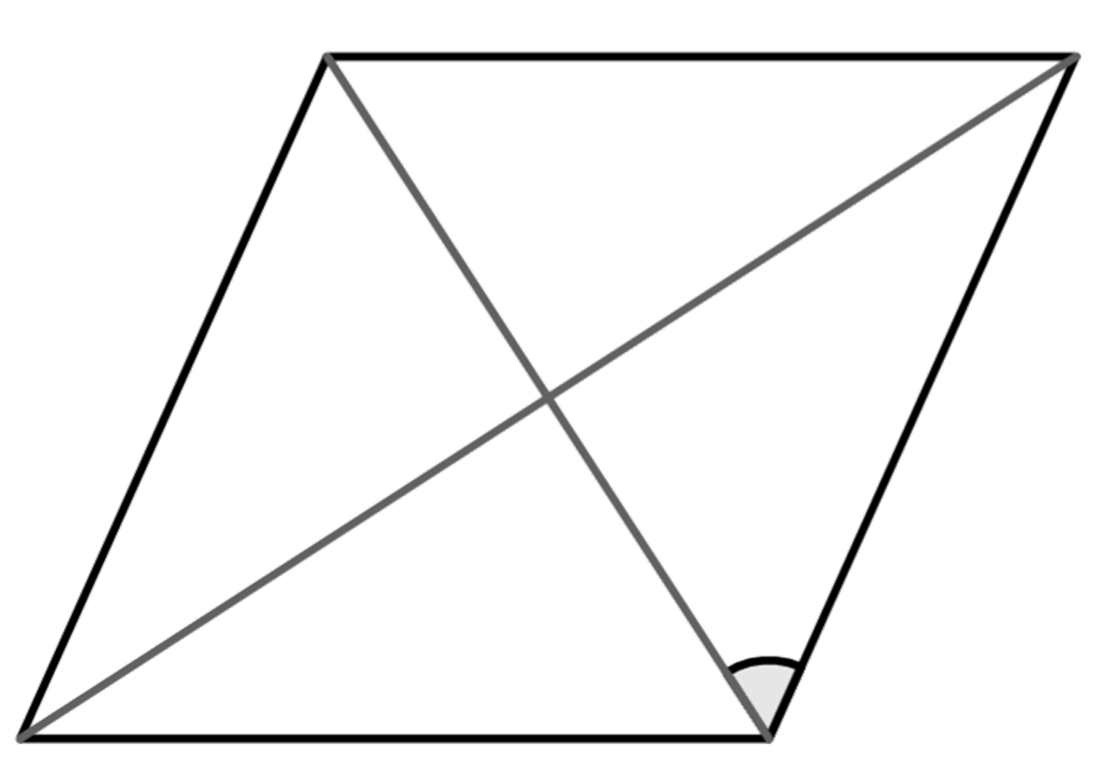
Diagonals of a rhombus
Task B: Properties of a rhombus
Task B: Properties of a rhombus
1) Work out the missing angles in these rhombi
1) Work out the missing angles in these rhombi
a)
a)
b)
b)
32°
110°
32°
110°
90°
90°
55°
55°
74°
35°
74°
35°
16°
16°
2) Work out the area of the rhombus in each part:
a) One diagonal is 8 cm and the other is 6 cm
b) One diagonal is 9 cm and the other is 4.5 cm
c) Half of one of the diagonals is 5 cm and the other diagonal is 1 cm
24 cm² E.g. (0.5 × 4 × 3) × 4
20.25 cm² E.g. (0.5 × 4.5 × 4.5) × 2
5 cm² E.g. (0.5 × 5 × 1) × 2
3) Construct a rhombus from this set of perpendicular lines.
3) Construct a rhombus from this set of perpendicular lines.
An example:
An example:
Mathematics in Education and Industry.
v2.3

